Slide 1
Electronic Voting
1106 Sang-woo Park
1609 Woo-jin Shim

Slide 2
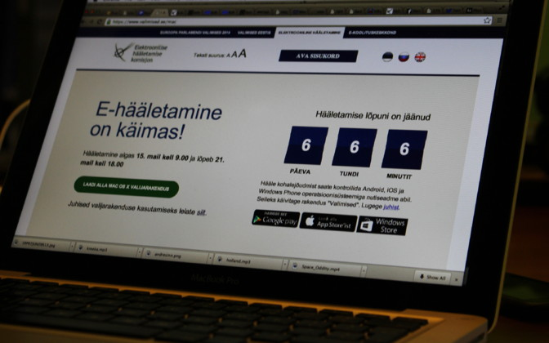
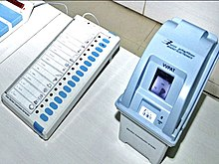
A new paradigm of voting
Estonia was the ﬁrst country in the world to use Internet voting nationally. According to Estonian government, 44% of its votes are done online.
India is using the voting machine as a general voting method since 2004 to prevent fraudulent voting and booth capturing.
Online voting page of Estonia
Voting machines of India

Slide 3
What is Electronic Voting?
Electronic voting: voting that uses electronic means to either aid or take care of casting and counting votes.
It is also known as e-voting.
Accuracy, anonymity, scalability, speed is required to an e-voting system.
There are three types of e-voting
- Paper based
- Direct-Recording E-voting (DRE)
- Public network DRE

Slide 4
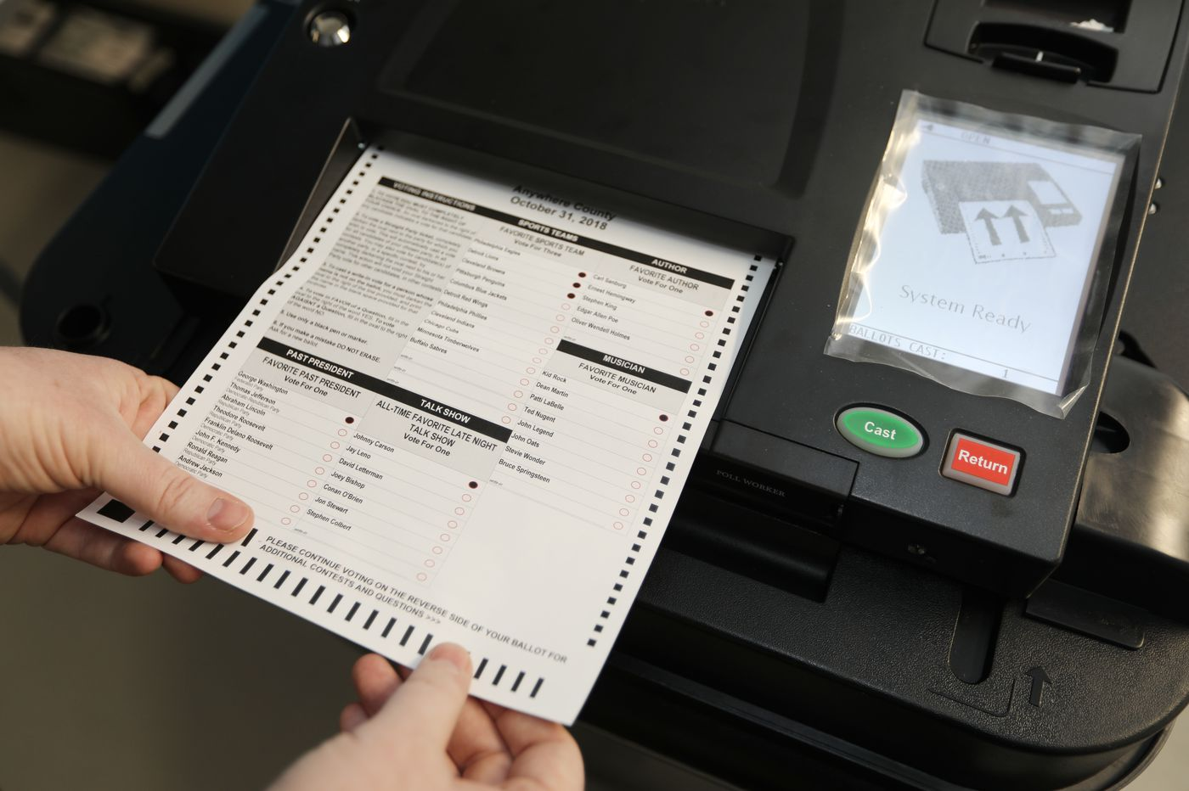
Voting Processes of E-Voting (1)
Paper based e-voting
Supplies : ballot paper, voting machine
Voters vote on machine.
Ballot is automatically checked and collected.
Scanning machine scans the ballot and counts the vote.
Counted data is sent to the server and calculated.
<Ballot for electronic voting>

Slide 5
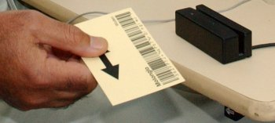
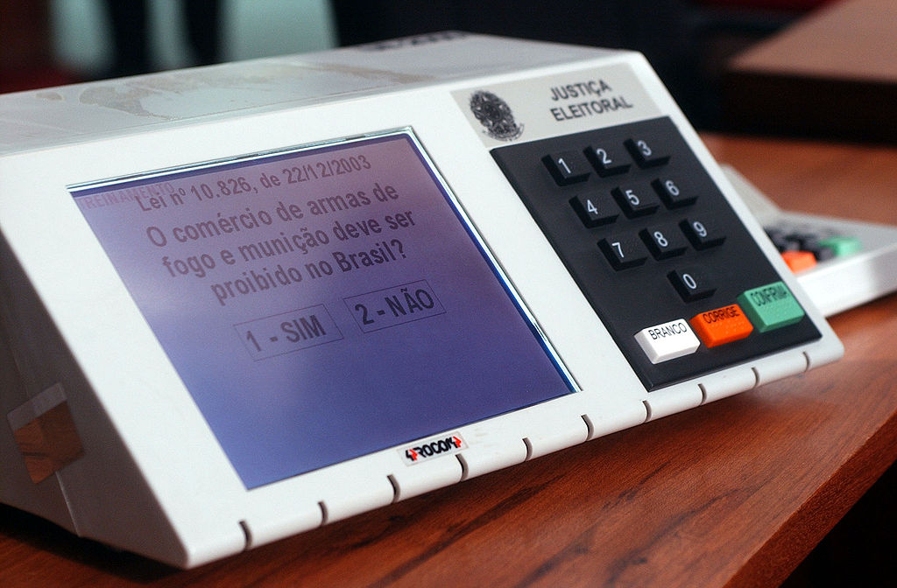
Voting Processes of E-Voting (2)
DRE voting System
Supplies : DRE voting machine, identification card
Identification is done using ID card or entering personal information.
Voter vote by following the machine’s guide.
Machines transmit the result to central server.
<Identification card>
<DRE voting machine>

Slide 6

Voting Processes of E-Voting (3)
Online voting System
Supplies : PC or KIOSK, central server
Has many similarities with normal DRE voting System
Usually doesn’t use a voting booth
Voting progress is done through personal devices
<Online Voting>

Slide 7
Side effects on human life
Errors on
e-voting system
Election results get uncertain
Damage on social trust
Can lead to social disputes
Threats to vote on
specific candidate/party
Personal information exposed
Can be used in crimes
Fake passport
Credit card theft
Errors on e-voting system can change the result of the election. These errors can damage social trust about the election result. This can lead to disputes between supporters of different parties.
Voters need personal information to identify themselves and vote. If these information is exposed, it can be used in crimes such as credit card fraud, fake passport, etc.

Slide 8
Vulnerabilities & Alternatives of PBV & DRE
PBV&DRE use public network to send voting results to the server
Leaking voting result
Interruption/Modification transmit
DoS attack to Server
Make an Intranet between Server and Client
Intranet: Computer network with only pre-authorized member in some organization
Prevent outer network attack, such as DoS, network hijacking
Risk of physical hacking still exists

Slide 9
Vulnerability of online voting
Client(voting individuals) (usually PC)
- hard to be controlled by the government
- cracking malware → leak data, tampering
- OS and hardware Vulnerabilities → leak data or unauthorized execution
Central server
- same problems to client
- DDoS attack → leak or modify data
- government control is able

Slide 10
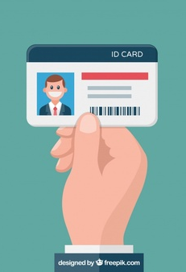

Safeguards in online voting
Data encryption: HTTPS protocol(SSL/TLS), AES encryption
- Prevents data leak and modification
- Protects personal information
Require/Check Individual information
- Blocks unauthorized access
- Prevents double vote
<https secure protocol>

Slide 11
Protecting the voting server
Choose trustful certificate and update it often
Use a DDoS mitigation service
- Cloudflare, Imperva Incapsula, etc.
DDoS mitigation service decrypts every data between the server and the user to determine the traffic. (allowed "man-in-the-middle" attack?)
Virus checking software can catch viruses(but not new ones).

Slide 12
Opinions about e-voting
We should use electronic voting.
Modern citizens are used to interfaces of electronic devices. Also, more and more countries are adopting electronic voting.
→ We should adapt to the trends.
Typical paper voting has the security and integrity problem too.
We shouldn’t use electronic voting yet.
Possibility of automated vote buying/selling
→ Requires both software and law upgrades
Public network can be accessed from worldwide
→ Much more difficult to protect the system

Slide 13
References
Analyzing Internet voting security - https://escholarship.org/uc/item/2658f82g
Security Analysis of the Estonian Internet Voting System-https://dl.acm.org/doi/pdf/10.1145/2660267.2660315?download=true
https://en.wikipedia.org/wiki/Electronic_voting

